Slide 1

Surety Bonds

Slide 2
Agenda
What is Surety? Cases
Process: How does it work?
Insurance Vs Surety
Types of Surety
Related Documents & Forms in Surety
A Look at CapSpecialty Surety & Fidelity offering

Slide 3
Course Outline
1
What is Surety?
Surety Process: How does it work?
Types of Surety
Insurance Vs Surety
Surety Glossary
2
Related Documents & Forms in Surety
Surety & Fidelity offering

Slide 4
Understanding Surety: Case 1
Maid/ Driver Providing Agency
Maids/ Driver
Surety gives the performance directions
Surety
Principal
Obliges the Owner by performing the obligations.
Agency Assures the Owner of the obligations to be fulfilled by Principal
Owner
Obligee

Slide 5
Understanding Surety : Case 2
A construction Company i.e. ‘The Developer ABC’ agrees to build a ‘School Building’ for a ‘School Board/ Owner’
Surety gives the performance directions
School Building
Developer ABC
Surety
Principal
Obliges the Owner by performing the obligations.
Developer Assures the Owner of the obligations to be fulfilled by Principal
School Owner
Obligee
Notes:
Obligee; He is to be obliged..The benefits has to pass on to him.
as Payee, Consignee, Saler – buyer concept, school being sold by the developer to the owner, so if there is some fault with the school, he will be liable for it. So the Developer has to take surety and provide assurance on the behalf on the school contractors/ services/ quality.
Principal : Focus, subject Matter

Slide 6
What is Surety ?
There is a legal bonding ( Surety Bonds) which gives an assurance that if the something goes wrong the ultimate responsible person will be liable to compensate.
The obligee - the party who is the recipient of an obligation.
The principal - the primary party who will contractually perform the obligation.
The surety - who assures the obligee that the principal can perform the task.
A surety bond or surety is a promise to pay one party (the obligee) a certain amount, if a second party (the principal) fails to meet some obligation, such as fulfilling the terms of a contract. The surety bond protects the obligee against losses resulting from the principal's failure to meet the obligation.

Slide 7
Surety Bonds Vs Insurance
The Contract of Bond
Three Parties- Surety, Principal and Obligee
If the Principal defaults and the Surety has made the payment, The Surety enjoys the legal right to collect its loss from the Principal
Losses covered are within human control as honesty, capacity and ability of the individual to perform
The Bond Can not be cancelled unless it has been determined that all the obligations of the Principal have been fulfilled
The Contract of Insurance
Two parties – Insurer and Insured (TP not a part of contract)
In case of loss, the Insurer does not have the right to recover losses from the insured
Losses covered are usually outside the human control ( Accidental, Unexpected)
The Contract of Insurance is Cancelable by either parties, and non payment of the of the premium by the insured permits the insurer to obviate its liability

Slide 8
The Contract of Suretyship : Features
The Contract of Suretyship begins by naming all the three parties stating that ‘A’ as Principal and ‘B’ as Surety are bound to ‘C’ as obligee in a specified amount, called the bond penalty or penal Sum i.e. the maximum liability of the parties to the bond.
Date of the Bond- the date on which the contract was executed and signed by, the principal and surety.
The extent of the Principal’s and surety’s obligation is described i.e. having fulfilled the obligation the Principal and Surety are relieved, however, if not fulfilled bond is in force to protect obligee
Contract of Surety is one of indemnity i.e. onus of proof lies with obligee - Obligee has to prove the measure of money damages suffered due to the Principal’s default.
Some bonds stipulate certain amount of payment by Principal without any alternative, thus no need of damages to be proven.
Bond where, the principal fails to pay Surety has to do - Financial Guarantees
Bond where the entire amount is payable on the failure of the Principal’s performance – Forfeiture Bonds or Bail Bond
Bond, where no stated limit for the payment and payment of full measure of damages was agreed – Open Penalty Bond

Slide 9
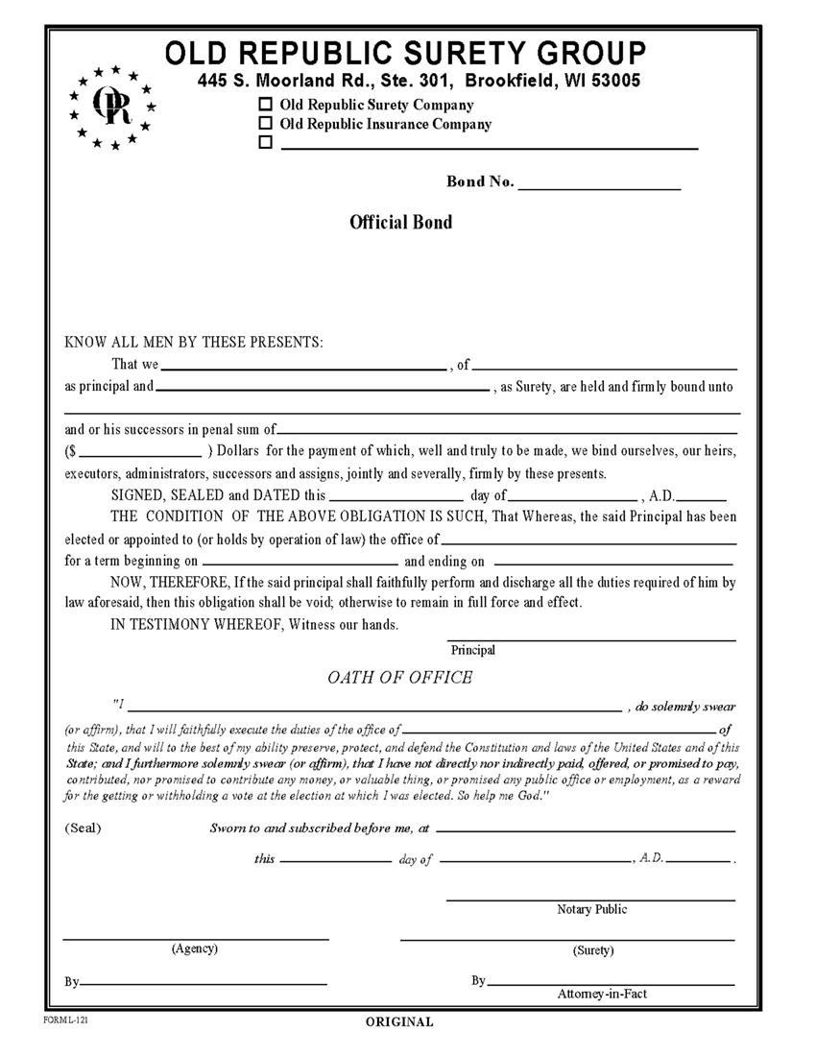
How does it look like? : Sample 1

Slide 10
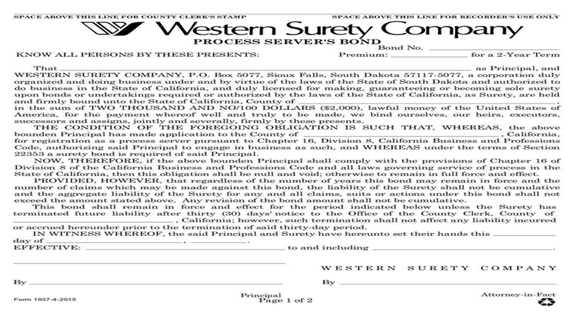
How does it look like? : Sample 2

Slide 11
How Does the Surety Work?
Borrower approaches the Surety Company
Surety co. does Credit Rating Analysis
Company writes the Surety bond
Borrower becomes the Surety
Principal performs the obligation
Satisfied
Directions
Not Satisfied
Indemnify
Indemnification
Surety assures/ indemnifies, obligee of the Principal’s services
Services, Term & Conditions
Company Does not writes the Surety bond
Start
Premium
Direct penalty
Obligee gets the Obligations
Borrower approaches Bank
Not Satisfied
Satisfied
Borrower gets the Letter of Credit from the Bank
Borrower does the Reimbursement Agreement
End

Slide 12
Types of Surety
License and Permit Bonds:
Bonds which are required to obtain a license or permit in any city, county or state.
These bonds guarantee whatever the underlying statute, state law, municipal ordinance or regulation requires.
They may be required for a number of reasons, for example the payment of certain taxes and fees
and providing consumer protection as a condition to granting licenses related to selling real estate or motor vehicles and contracting services.
It protects the Govt. body also, which provide the licenses.
Court Bonds :
Bond guaranteeing the payment of the cost of a trial. May also be called a Cost of Appeal bond.
Fiduciary Bonds:
Bonds which guarantee an honest accounting and faithful performance of duties by administrators, trustees, guardians, executors and other fiduciaries ( court appointed persons)
Fiduciary bonds, in some cases referred to as probate bonds, are required by statutes, courts or legal documents for the protection of those on whose behalf fiduciary acts.
They are needed under a variety of circumstances, including the administration of an estate and the management of affairs of a trust or a ward.

Slide 13
Types of Surety…..Contd.
Public Official Bonds:
Bond that guarantees a public official will act with honesty and/or faithful performance. These bonds are required by statutes and ordinances as State or Local Treasurer whose function is to manage public funds, Tac collectors, auditors etc.
Contract Bonds:
Bond designed to guarantee the performance of obligations under a contract.
These bonds guarantee the obligee that the principal will perform according to the terms of a written contract. Construction contracts constitute most of these bonds.
Contract bonds protect a project owner by guaranteeing a contractor’s performance and payment for labor and materials.

Slide 14
Some Common Surety Terms
Attachment: The legal process of taking possession of a defendant’s property when the property is in dispute.
Balance Sheet: A financial statement listing assets, liabilities and net worth
Bankruptcy Trustee Bonds: Bonds which provide a guarantee to the beneficiaries of the bankruptcy that the bonded trustees, appointed in a bankruptcy proceeding, will perform their duties and handle the affairs according to the ruling of the court.
Blanket Bonds: Guarantees the honesty of all an organization’s employees.
Capacity: A term that refers to the size of a bond which a surety Company is able to write.
Collateral: Security held by the surety company to reduce the surety’s underlying risks when issuing a bond. Collateral may be in the form of cash, irrevocable letter of credit or real estate.
Conservator: A person, official or institution designated to take over and protect the interest of an incompetent or minor ( Custodian for the minor)
Cost Bonds: A type of bond guaranteeing the payment of the cost of a court trial. May also be called a Cost of Appeal bond.

Slide 15
Some Common Surety Terms
Damages: Term that refers to monetary measures of harm which may have occurred in a claim. (Not General Damages)
Defendant: The term that refers to the person or institution being accused in a court case.
Executor: A person appointed to execute a will.
Indemnification: The act of guaranteeing another repayment in the event of a loss.
Ordinance: A municipal regulation.
Plaintiff: The person or institution that brings an action/ a case against another in a court of law.
Appellant a person who applies to a higher court for a reversal of the decision of a lower court.
Replevin: An action of a law used to recover specific personal property
SBA: An acronym for the Small Business Administration. The SBA has a program to help small and minority owned contracting businesses obtain surety bond
Treasury Listing: A financial rating published by the federal government that lists the maximum size of federal bond a Surety Company is allowed to write.
Trustee: A trustee is a person named to manage a business’ assets and work with the business’ creditors.
Work-On-Hand Reports: A type of financial statements or schedule which lists a contractor’s jobs in progress.

Slide 16
Suggested Readings
Surety Glossary:
https://www.integritysurety.com/resources/our-glossary/
http://www.knowsuretybonds.com/bond_term_glossary.html
http://www.businessdictionary.com/definition/indemnitor.html
Other Suggested readings for the Pricing of the Bonds:
Construction Surety Bond Price Calculator on the App Store
Surety Bond Price Calculator - Android Apps on Google Play
Construction Surety Bond Price Calculator for iOS - Free ..
Argo Surety on the App Store - iTunes - Apple

